Slide 1
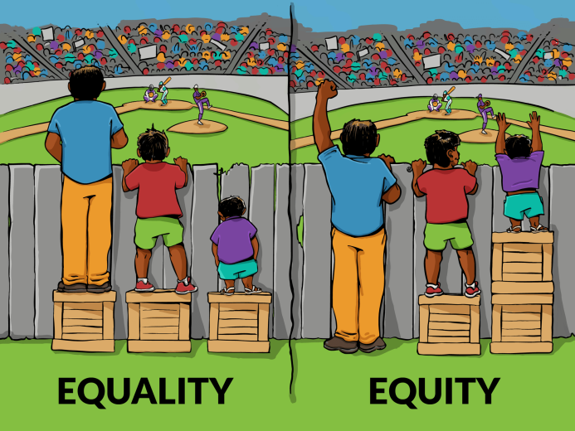
Equality
Equality means all citizens are equal.
Law of the state will also be equal for all.
The Indian constitution recognizes every citizen as equal
That is , no one will be discriminated by the state or government on any ground like caste, class, gender, colour, race, religion, tribe, educational or economic background etc.
There a are several laws in our country that ensure that people live with dignity and as equals.

Slide 2
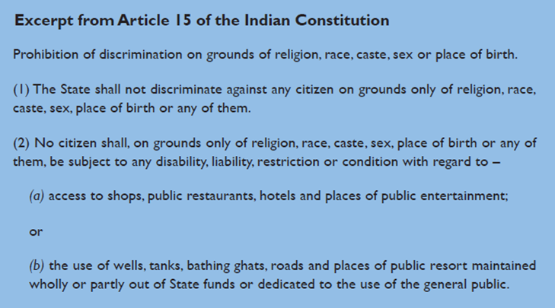
ARTICLE 15

Slide 3
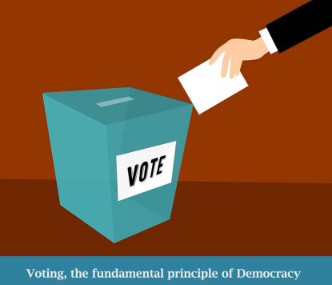
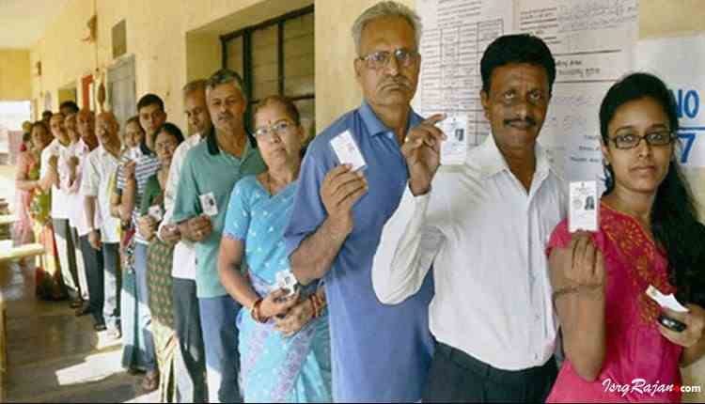
UNIVERSAL ADULT FRANCHISE
Universal Adult Franchise means that the right to vote should be given to all adult citizens without the discrimination of caste, class, colour, religion or gender.
In India , all citizens above the age of 18 can vote in the elections held periodically .
This allows people to participate in the decision making process of the country and make governments accountable for their actions .
It is a core principle of democracy

Slide 4
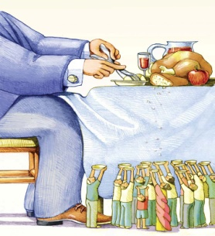
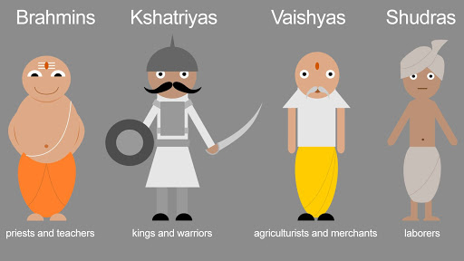
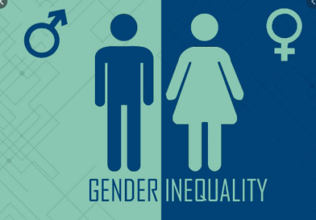
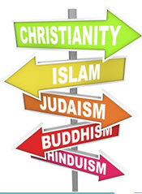
TYPES OF EQUALITIES
Political equality- all adults should have right to vote and participate in the decision making process of the country.
Economic equality - there should be no differentiation between rich or poor and there should be equal opportunities to all to grow and live with dignity.
Social equality - Lower caste and tribes should also be treated with respect and as equals
Gender equality -Men and women should have equal rights and opportunities
RELIGION- All regions and beliefs should be respected and considered equal

Slide 5
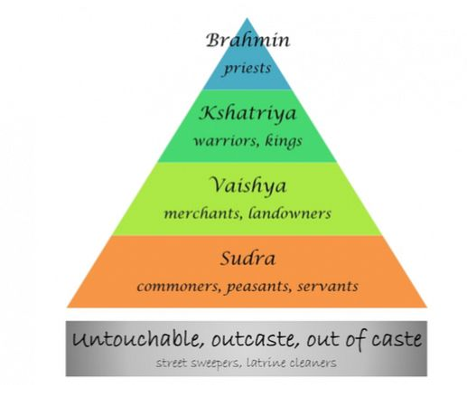
CASTE SYSTEM
Caste system was a social division based on occupation during the Vedic period but later ages these divisions became hereditary , discriminatory and oppressive for the lower castes.
It is a feature of Hinduism.
Main 4 caste divisions were:-
Brahamans
Kshatriyas
Vaishyas
Shudras
Untouchables or Dalits or Harijans

Slide 6
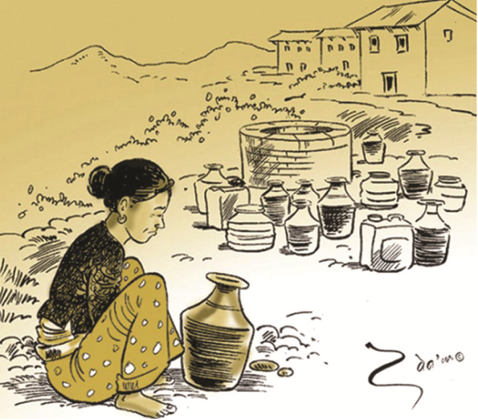
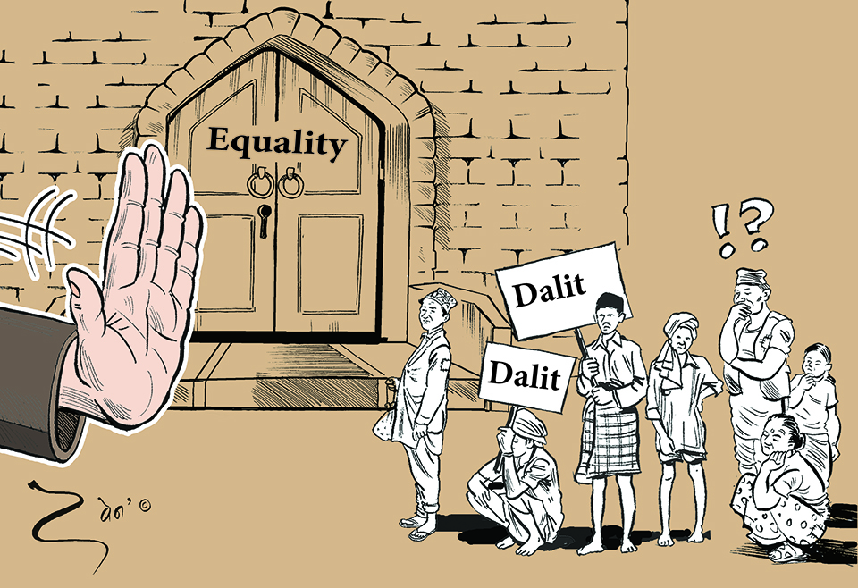
DALIT or UNTOUCHABLES
Dalit is a term that the so called lower castes use to address themselves.
Dalit means “broken”
By using this word “Dalit” lower castes are pointing to how they were and how they are seriously discriminated (broken) against by our society and upper caste.
In traditional Indian caste system, Dalits are members of the lowest caste who are highly discriminated by upper castes and class.
They were not allowed to mingle with other caste groups and were considered inferior .

Slide 7
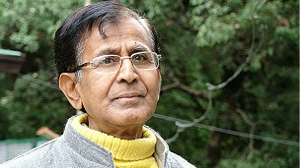
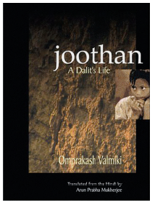
Om Prakash Valmiki
Omprakash Valmiki is a famous Indian Dalit writer.
His autobiography is named "Joothan " where he mentions how he was discriminated due to his caste in school and else where.
Because of his caste he had to sit away from others or at the back. He was beaten up for no reason.
The headmaster would make him sweep the school and playground while others studied.
His book throws light on the conditions of lower castes in India specially the Dalits

Slide 8
HUMAN DIGNITY
Dignity is the right of an individual to be valued and respected for what they are and to be treated ethically and equally.
Therefore, every human being has an inheritant right to live with respect and dignity.
In a democratic state, it is the responsibility of the state to ensure or recognize human dignity by giving certain fundamental /basic rights to its citizens.
Hence our constitution also gives us 6 fundamental rights like Right to freedom, right to equality etc to live our life with respect and dignity.

Slide 9
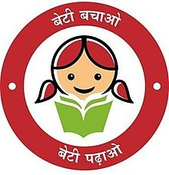
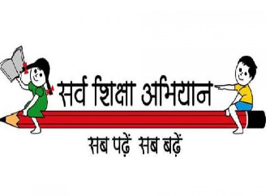
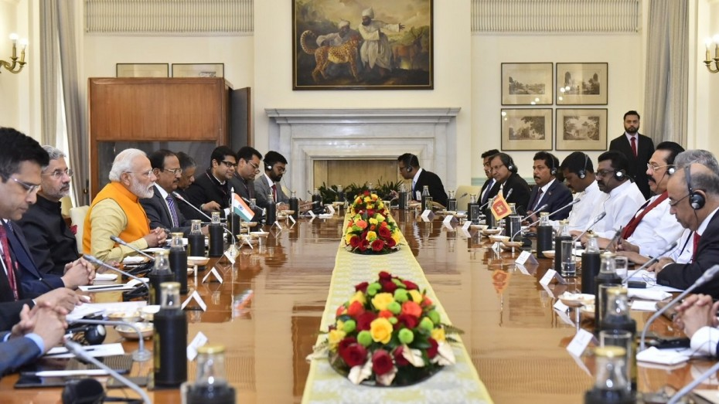
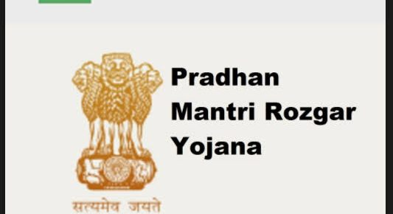
The two ways in which government implements equality
Government makes and executes certain laws in the favour of and to protect the people's right to be treated equally.
Promotion of government schemes and policies to improve the lives of communities and individuals who have been historically treated unequally and oppressed for ages.
Government also helps them get greater opportunities to improve their social and economic position in society.

Slide 10
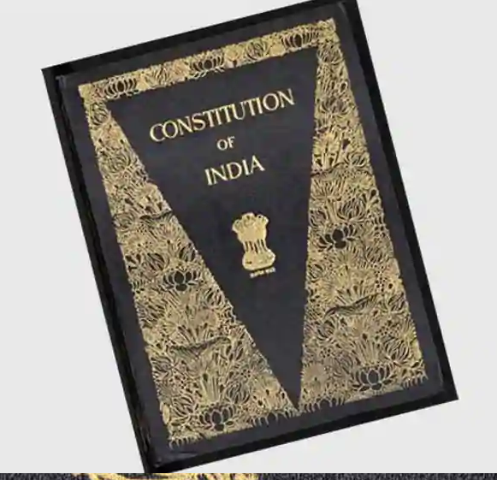
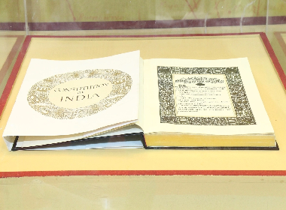
Provisions of Indian constitution that recognizes equality
Equality before law - that every person has to obey the same law irrespective of their social economic status or differences.
No one can be discriminated on the basis of religion, caste, class gender, colour, race, place of birth etc.
Every person has access to all public places like playground, hotels, markets, public wells, roads bathing ghats etc.
Untouchability has been abolished by the constitution.

Slide 11
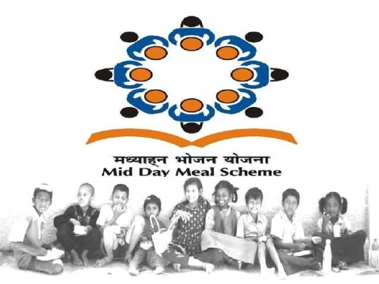
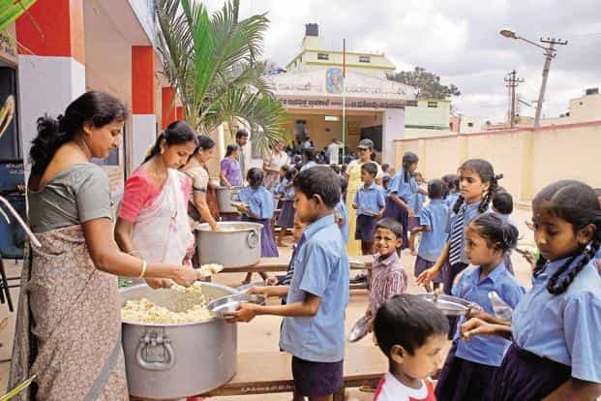
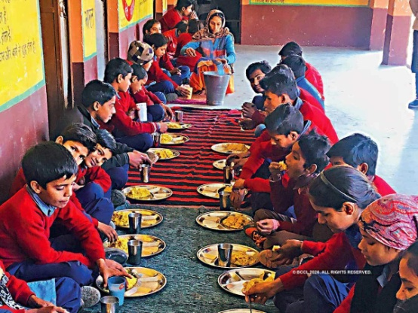
MID MEAL SCHEME
It is a government programme introduced in all government elementary schools to provide children with cooked lunch.
Tamil Nadu was first state to start this and in 2001 Supreme Court ordered all state governments to initiate it
Positives of Mid day Meal Scheme
More poor children enrolled and attended schools
Attendance and remain in school has improved.
Working mothers of school children do not have to interrupt their work to feed children and feel motivated to send them to school.
Helped reduce caste prejudice as both upper and lower caste students sit together to have meal
Helped reduce hunger if poor students who are now able to concentrate more due to full stomach.

Slide 12
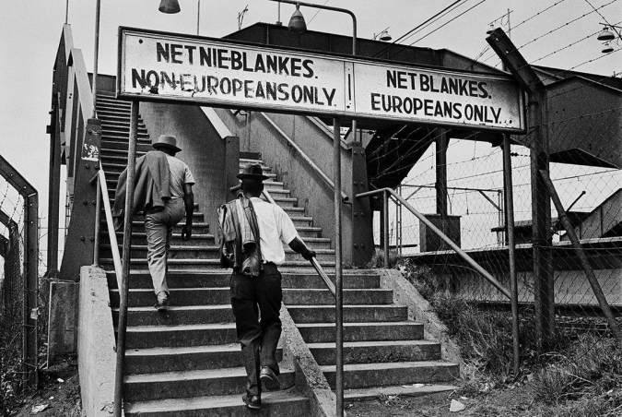
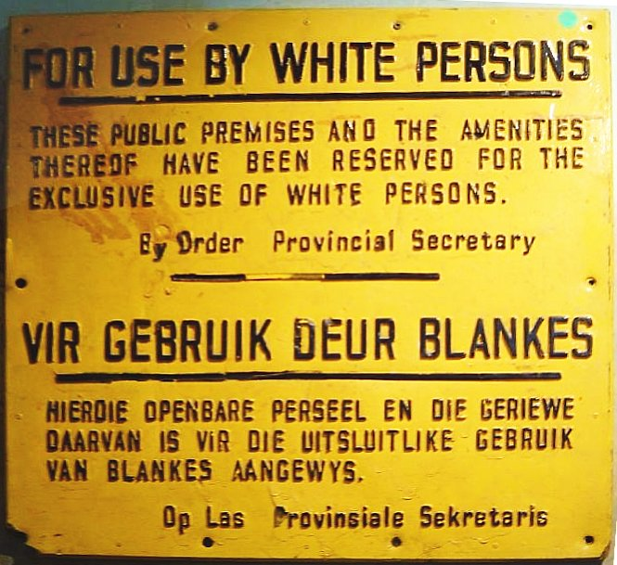
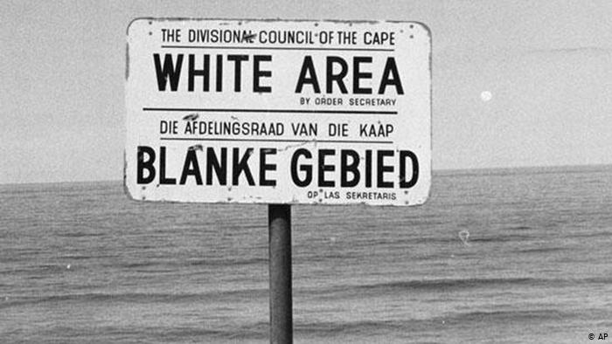
INEQUALITIES IN OTHER DEMOCRACIES
Before 1950’s , Afro Americans were treated extremely unequally in the countries like United States and were denied respect and equality through the law.
They were supposed to vacant seats in public transport for white people if he so wanted or sit at the back separately.
There were different markets schools etc. shops for blacks and whites

Slide 13
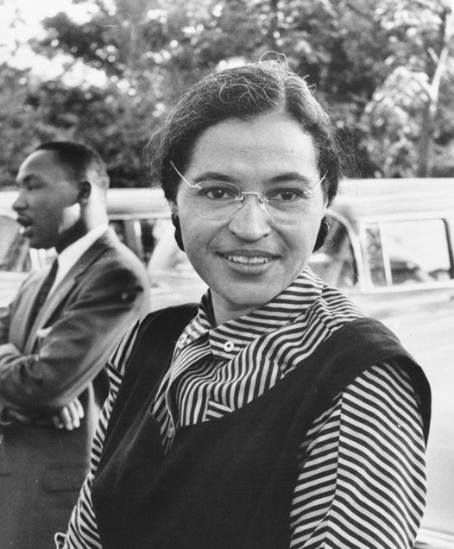
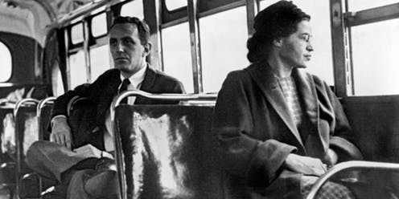
CIVIL RIGHTS MOVEMENT 1964
ROSA PARK was an Afro American women. In 1955 she refused to give her seat to a white man in a bus.
Her Refusal That day started a huge agitation against the discrimination and unequal treatment of the black citizens. This came to be popularly known as Civil Right Movement.
It subsequently led to the passing of the Civil Right Act of 1964 that prohibited discrimination on the basis of race religion or national origin.
It stated that the schools would be open to all children and there would not be separate
schools for blacks and whites..

Slide 14
THANK YOU !

